Slide 1
Remebrall
An Intelligent assistant to aid elders suffering from Alzheimer's disease
Pranoy K.
Jibin Rajan Varghese

Slide 2
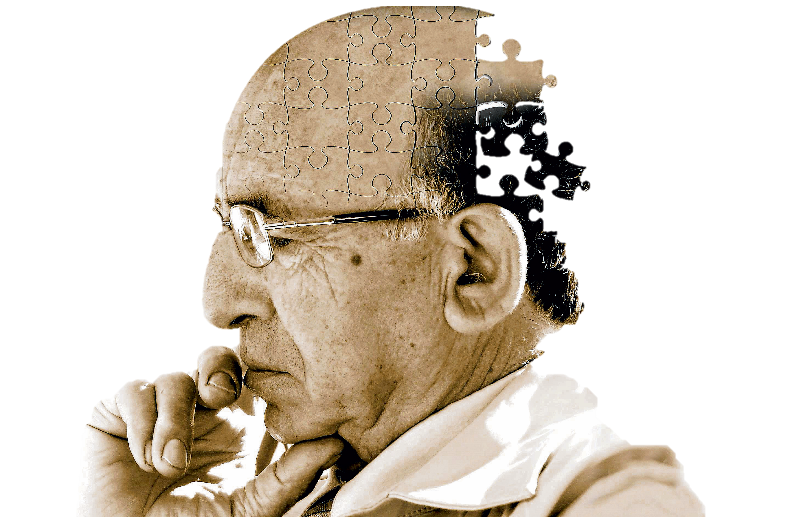
Personal Fitness is not About Youngsters alone…
What is Alzheimer’s Disease?
Symptoms : Forgetfulness
Technology to help
Why Remembrall?
Prototype Demo

Slide 3
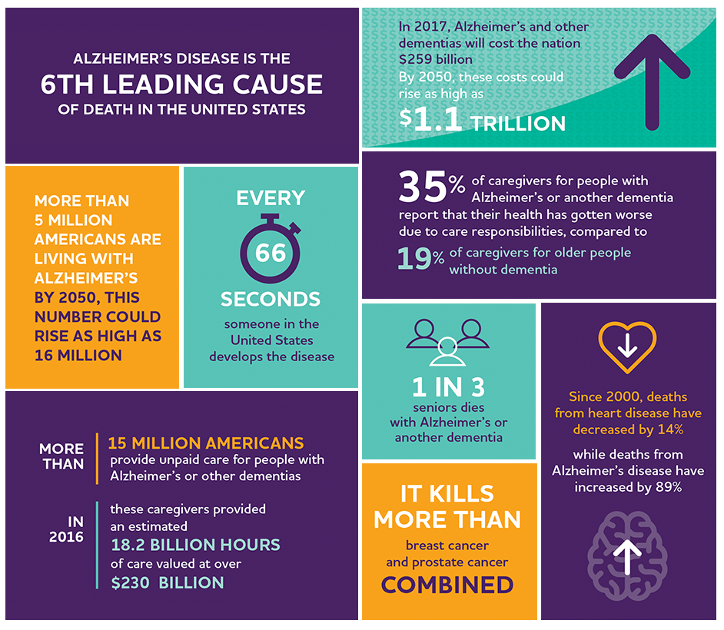

Slide 4
Thank You
Team Remembrall

